Slide 1

Data-401 – Final Assignment Data Set Analysis and Visualization – Global SuperStore

Slide 2
1 – Business Understanding –High Level
Notes:
For the High Level Business Understanding focus on the Case Study supplied.

Slide 3
Business Study
Business Study – Global Superstore Dataset
Reference Link -
https://www.kaggle.com/datasets/shekpaul/global-superstore

Slide 4
Introduction
Perspective – Global Superstore has been monitoring important KPIs (Sales, Profits etc.) across its various markets across globe. It hired Falcon Analysts, a Data Analytics company based out of Calgary, to suggest recommendations for deriving business growth. To address this, Falcon Analysts will be leveraging internal sales data-set to enable strategic business decisions of Global Superstore.

Slide 5
5W 1H Analysis 1 – Who
# | Question | Answer
Q1.1 | Who is involved? | Global Superstore, Falcon Analysts, Customers, Salesperson, Suppliers, Countries, Markets and Regions.
Q1.2 | Who is affected? | Global Superstore, Customers, Salesperson, Countries, Markets, Suppliers, Regions.
Q1.3 | Who will benefit? | The Global Superstore and Falcon Analysts will be benefited.
Q1.4 | Who will be harmed? | Global Superstore and Data Analytics company will be harmed.
Notes:
The questions on this slide are sourced from this article:
https://premium.wpmudev.org/blog/a-simple-sure-fire-way-to-create-great-content-the-5-w-the-h/
Who is involved?
Who is affected?
Who will benefit?
Who will be harmed?

Slide 6
5W 1H Analysis 2 – What
# | Question | Answer
Q2.1 | What is your topic narrowed down in a simple phrase/sentence? | Global Superstore has hired Falcon Analysts to get actual business insights for addressing some strategic business questions supported by data driven analysis.
Q2.2 | What does your topic involve? | It involves multiple dimensions like Product Name, Order Date, Market and Product Categories, and facts like Profit amounts, Sales per order and Discounts given per order.
Q2.3 | What is it similar to / different from? | Similar datasets could include sales data from different companies, stores, or time periods. Differences could arise in terms of the types of products, regions covered, or additional variables like customer demographics, sales channels, or marketing strategies.
Q2.4 | What might be affected by your topic? | Sales can be country and region specific along with various decisions regarding discounts which can have direct or in-direct impact
Notes:
The questions on this slide are sourced from this article:
https://premium.wpmudev.org/blog/a-simple-sure-fire-way-to-create-great-content-the-5-w-the-h/
What is your topic narrowed down in a simple phrase/sentence?
What does your topic involve? (i.e. What are the different parts to it?)
What is it similar to / different from?
What might be affected/changed by your topic?

Slide 7
5W 1H Analysis 3 –When
# | Question | Answer
Q3.1 | When did this take place? When will it take place? When should this take place? | This sales from Global Superstore took worldwide from the year 2011 to 2014. Falcon Analysts will predict for the future years as well.
Q3.2 | Does when this takes place affect the topic? | Yes, the timings like order and shipping dates do have key roles to play in determining the trend of profitability margins and annual sales in all the markets that are involved with the Global Superstore.
Notes:
The questions on this slide are sourced from this article:
https://premium.wpmudev.org/blog/a-simple-sure-fire-way-to-create-great-content-the-5-w-the-h/
When does this take place? When did this take place? When will it take place? When should this take place?
Does when this takes place affect the topic?

Slide 8
5W 1H Analysis 4 – Where
# | Question | Answer
Q4.1 | Where did this take place? | Global sales captured across different markets of various regions such as Central, South, East, West, Africa, AMEA (Asia, Middle East, and Africa), Canada and some other regions.
Q4.2 | Does it matter where it takes place? Is it affected by location? | Yes, the location where products are sold is crucial since selling price and profit margins differ from place to place which has direct or indirect impact on the business insights.
Notes:
The questions on this slide are sourced from this article:
https://premium.wpmudev.org/blog/a-simple-sure-fire-way-to-create-great-content-the-5-w-the-h/
Where does this take place? (Where did it …. Where will it … Where should it ….?)
Does it matter where it takes place? Is it affected by location?

Slide 9
5W 1H Analysis 5 – Why
# | Question | Answer
Q5.1 | Why is this topic important? Why does it matter? | This topic is important to get actual data driven insight and predict which market or region is leading to profitability & sales and helping Global Superstore in making business decisions accordingly.
Q5.2 | Why do certain things happen? (What are some causes and effects within the topic?) | Certain things like profitability margins of Office supplies is highest in 2014 which helps to predict its actual growth or decline in the coming years. Hence, every data in the company dataset is important for future data insights.
Notes:
The questions on this slide are sourced from this article:
https://premium.wpmudev.org/blog/a-simple-sure-fire-way-to-create-great-content-the-5-w-the-h/
Why is this topic important? Why does it matter?
Why do certain things happen? (What are some causes and effects within the topic?)

Slide 10
5W 1H Analysis 6 – How
# | Question | Answer
Q6.1 | How does this topic work? How does it function? How does it do what it does? | The given dataset captures sales data for various products in different markets and regions. By analyzing this information, Falcon Analysts can help Global Superstore to make decision on which products are popular, how pricing strategies and discounts impact sales, and how shipping costs affect overall profitability margins.
Q6.3 | How are those involved affected? | All the involved parties such as Global Superstore, customers, and countries are directly affected by the data driven insights as it can derive various insights which might change the discounts given per product and reduce sales figures in particular market.
Notes:
The questions on this slide are sourced from this article:
https://premium.wpmudev.org/blog/a-simple-sure-fire-way-to-create-great-content-the-5-w-the-h/
How does this topic work? How does it function? How does it do what it does?
How did it come to be?
How are those involved affected?

Slide 11
2 – Data Understanding – High Level

Slide 12

Data Modeling – Conceptual Model
Parties Involved
Global Super Store
Countries
Customers
States
Suppliers
Cities
Market
Region
Customer Attributes
Customer ID
Customer Name
Product
Product ID
Product Name
Product Category
Product Sub-Category
Orders
Order ID
Order Date
Shipping Date
Ship Mode
Order Priority
Sales
Total Selling Price
Quantity
Discount
Profit
Shipping Cost

Slide 13
Data Dictionary
No | Topic | Definition
1 | Stakeholders | The term "stakeholders" refers to individuals, groups, or entities that have an interest, concern, or "stake" in a particular organization, project, or system.
2 | Geographical context | Geographical context refers to the physical, spatial, and locational aspects of a particular area or region and how these factors influence or provide a backdrop for various activities, events, or phenomena.
3 | Customer demographics | Customer demographics refer to the characteristics and attributes of a company's customer base such as age, gender, income, education, location, and more.
4 | Regional trends | Regional trends refer to patterns, developments, and changes that occur within specific geographical regions or areas.
5 | Sales channels | Sales channels refer to the various methods and platforms through which businesses or organizations distribute and sell their products or services to customers.
6 | Business Insights | A business insight is a result of analyzing relevant data with the goal of using it to understand, change, and improve your business.
7 | Profitability Margin | Profit margin is a financial ratio that measures the percentage of profit earned by a company in relation to its revenue.
8 | Shipping Cost | Shipping costs are the direct costs of moving an item from a shelf in your shop or warehouse to a customer's doorstep.

Slide 14
1 (Revisited) – Business Understanding – Low Level

Slide 15
Business Questions
At an estimated CAGR of 10%, what is expected 2020 sales for the country with highest sales in 2014? Considering top 10 countries by sales, does this country remain at top in terms of profitability margin as well?
Identify Top Salesperson by sales at Global level? In real terms, is Sales metric a sole effective KPI to identify top performer in the organization? Please justify.

Slide 16
2 (Revisited) – Data Understanding – Low Level

Slide 17
Data Set(s)
Global Superstore.xls
Global Superstore.csv

Slide 18
3 – Data Preparation

Slide 19
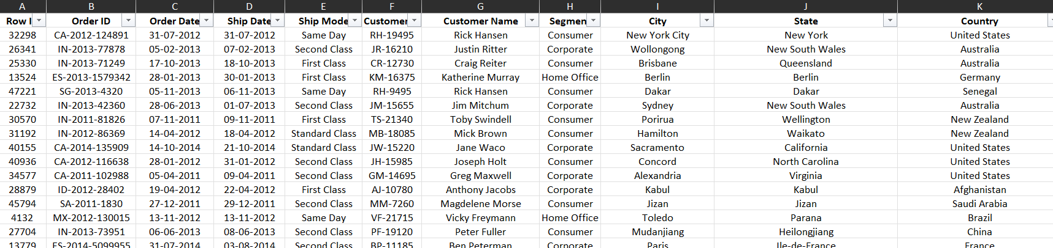
Data cleansing – Original Dataset
The dataset comprised of 24 columns and 51,290 rows
Row ID
Order ID
Order Date
Ship Date
Ship Mode
Customer ID
Customer Name
Segment
City
State
Country
Postal Code
Market
Region
Product ID
Category
Sub-Category
Product Name
Sales
Quantity
Discount
Profit
Shipping Cost
Order Priority
Notes:
Document any data cleansing that was required, any quality issues encountered with the data.

Slide 20
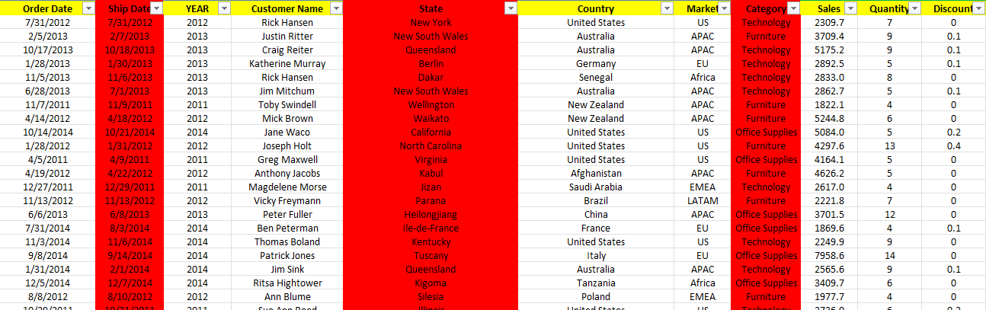
Data cleansing – Refined Dataset for further analysis
The refined dataset now comprised of 8 columns and 51,290 rows
Tool used for refinement – Microsoft Excel
Columns after cleansing
Order Date
Order Year
Market
Category
Salesperson/Customer Name
Quantity
Discount
Profit
Sales
The columns with red background are deleted. So, the refined data now constitutes 8 columns
Notes:
Document any data cleansing that was required, any quality issues encountered with the data.

Slide 21
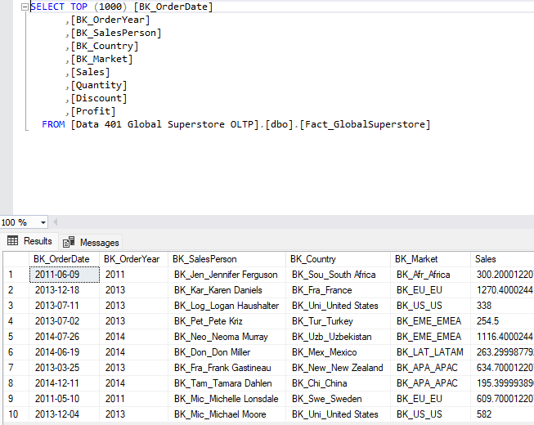
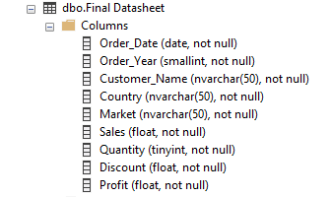
Data Preparation – Importing Excel data in SSMS
The data is saved as Global Superstore OLTP in the SSMS. The data is OLTP data (Transactional data and less refined)
Notes:
Use the SQL Server Management Studio (SSMS) tool to produce the SQL Query.
In this slide provide the SQL Query in text format, not screen shot format.

Slide 22
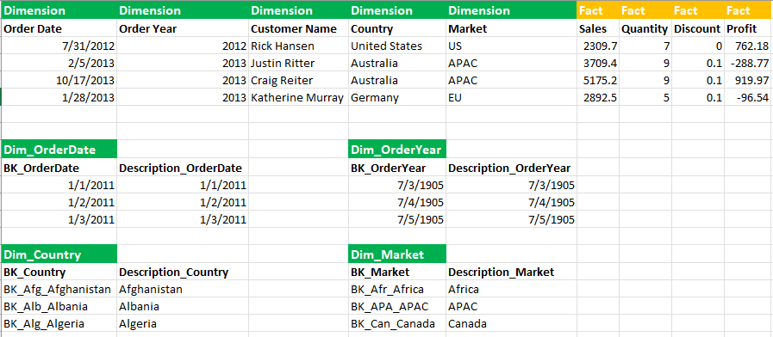
Data Preparation – Derivation of Dimensions and Facts
This step involves identification of Dimensions and Facts:
Dimensions (Order Date, Order Year, Market, Country, Salesperson). These dimensions would be base components of Data Warehouse (DW). This is OLAP data which is more useful from the analytical perspective
Facts (Sales, Quantity, Discount and Profit)
*BK represents Business Key
Notes:
Use the SQL Server Management Studio (SSMS) tool to return the results of the SQL Query.
In this slide have a screen shot of the results.

Slide 23
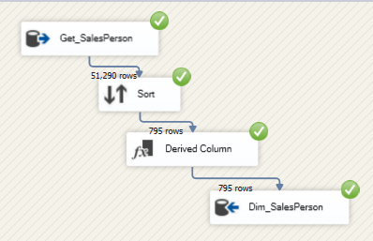
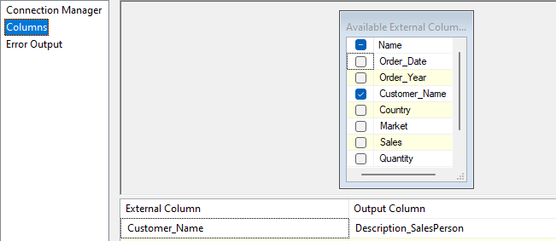
Data Preparation – Creation of Dimensions in SSIS (1 / 4)
1 step - Get_SalesPerson
Notes:
Use the SQL Server Management Studio (SSMS) tool to produce the SQL Query.
In this slide provide the SQL Query in text format, not screen shot format.

Slide 24
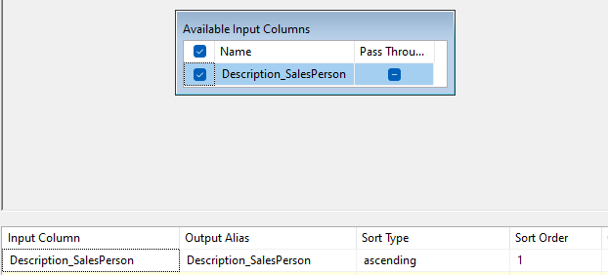
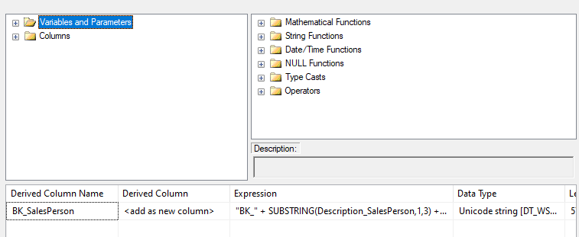
Data Preparation – Creation of Dimensions in SSIS (2/4)
2nd Step - Sort
3rd Step - Derived Column
Notes:
Use the SQL Server Management Studio (SSMS) tool to return the results of the SQL Query.
In this slide have a screen shot of the results.

Slide 25
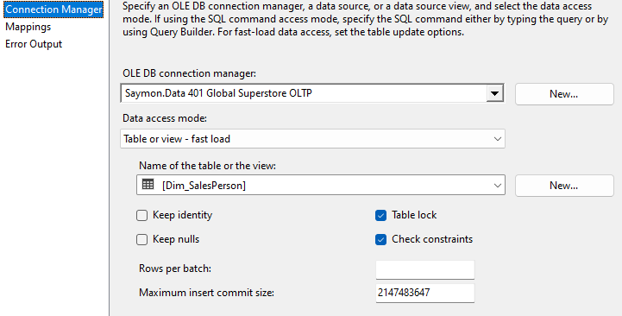
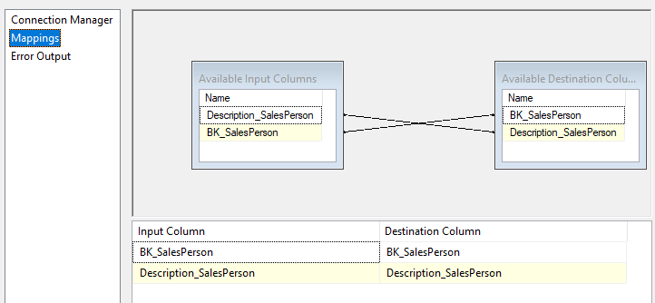
Data Preparation – Creation of Dimensions in SSIS (3 /4)
4th Step - Dim_SalesPerson
Notes:
Use the SQL Server Management Studio (SSMS) tool to return the results of the SQL Query.
In this slide have a screen shot of the results.

Slide 26
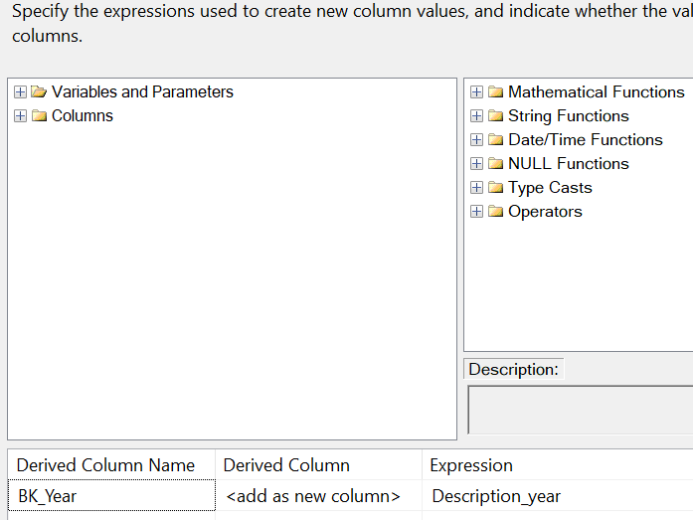
Data Preparation – Creation of Dimensions in SSIS (4/4)
Dim_Year
Notes:
Use the SQL Server Management Studio (SSMS) tool to return the results of the SQL Query.
In this slide have a screen shot of the results.

Slide 27
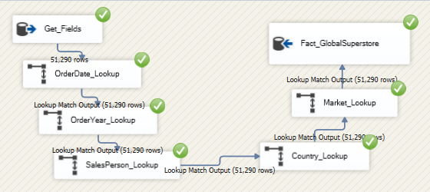
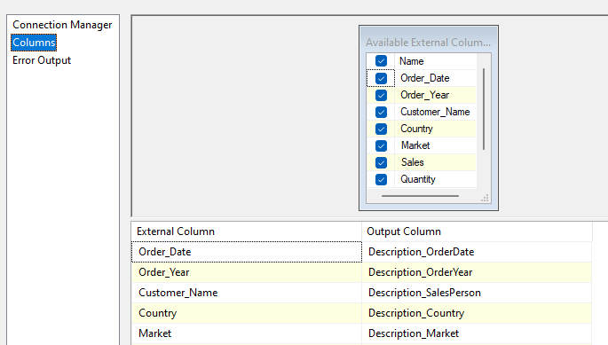
Data Preparation – Creation of Facts in SSIS
Step1 - Get_Fields
Notes:
Use the SQL Server Management Studio (SSMS) tool to return the results of the SQL Query.
In this slide have a screen shot of the results.

Slide 28
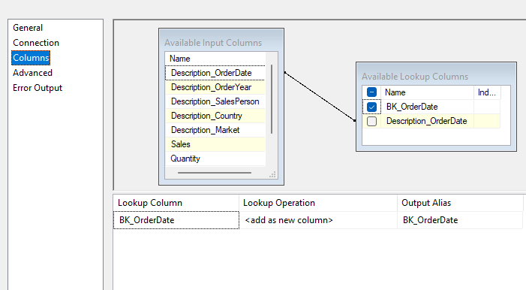
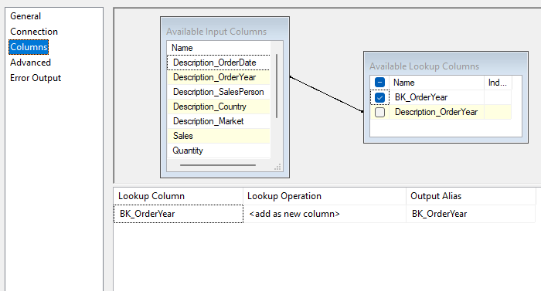
Data Preparation – Creation of Facts in SSIS
Step2 - Order Date Look up
Step3 - Order Year Look up
Notes:
Use the SQL Server Management Studio (SSMS) tool to return the results of the SQL Query.
In this slide have a screen shot of the results.

Slide 29
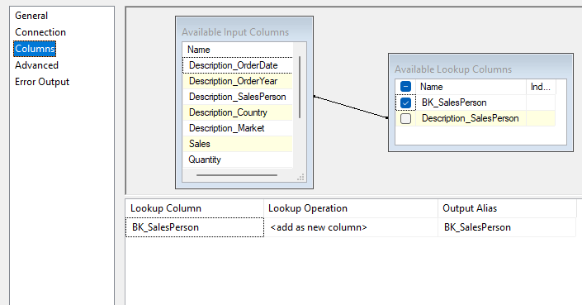
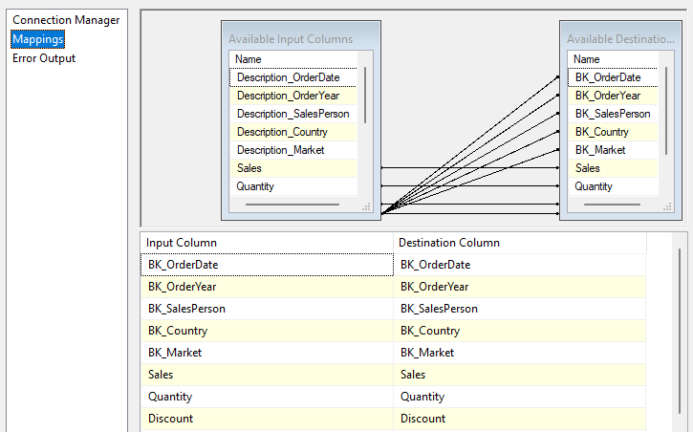
Data Preparation – Creation of Facts in SSIS
Step3 - Sales Person Look up
Step4 - Facts_GlobalSuperStore

Slide 30
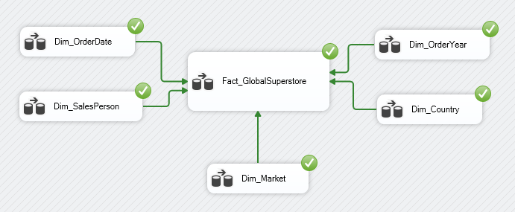
Data Preparation – Successful execution of different steps in Control Flow step of SSIS

Slide 31
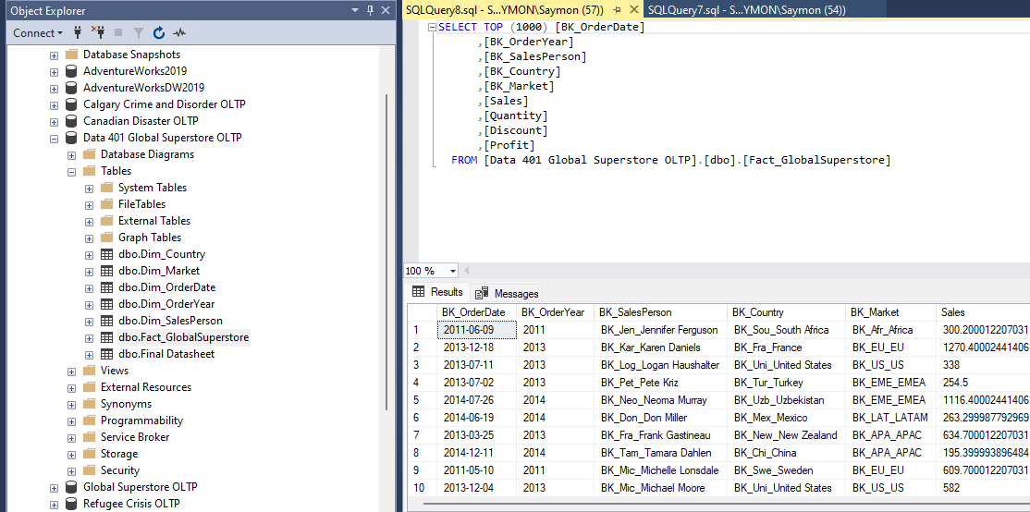
Data Preparation – Facts_GlobalSuperStore update in SSMS after successful execution of Control Task in SSIS

Slide 32
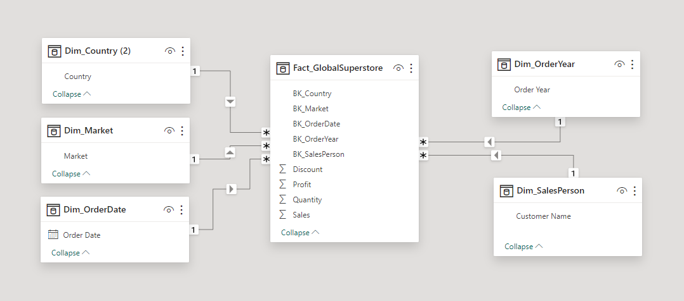
Database Diagram – Relationship between Dimensions and Facts

Slide 33
4 – Modeling

Slide 34
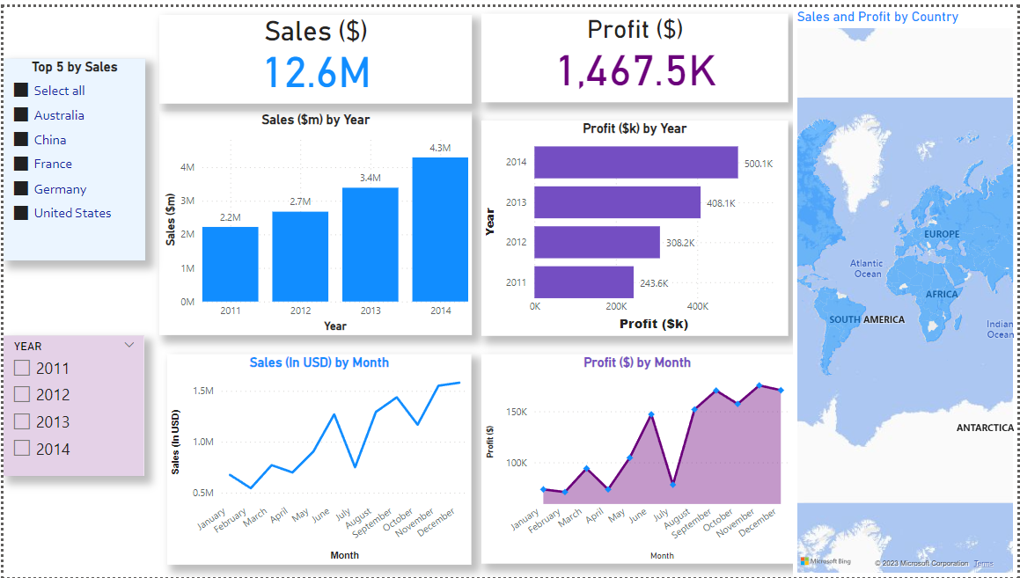

Slide 35
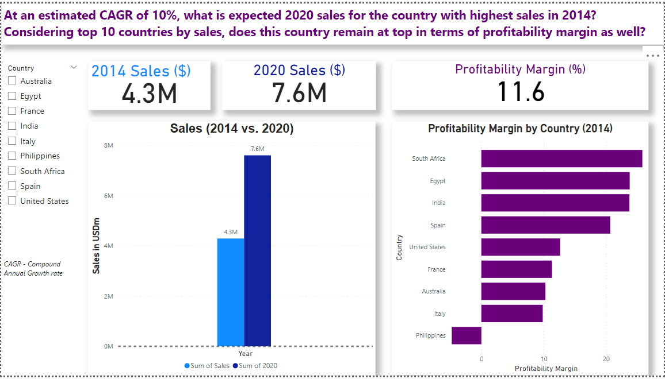

Slide 36
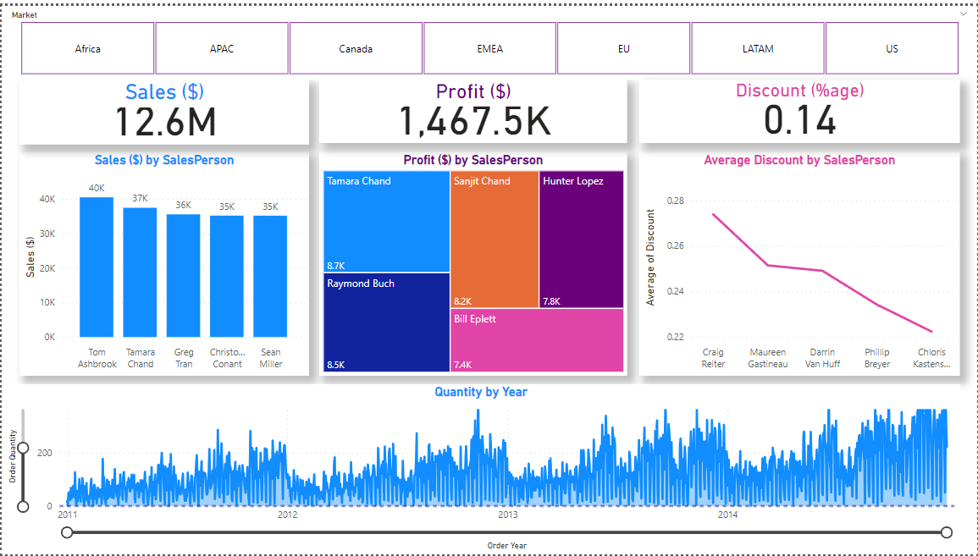

Slide 37
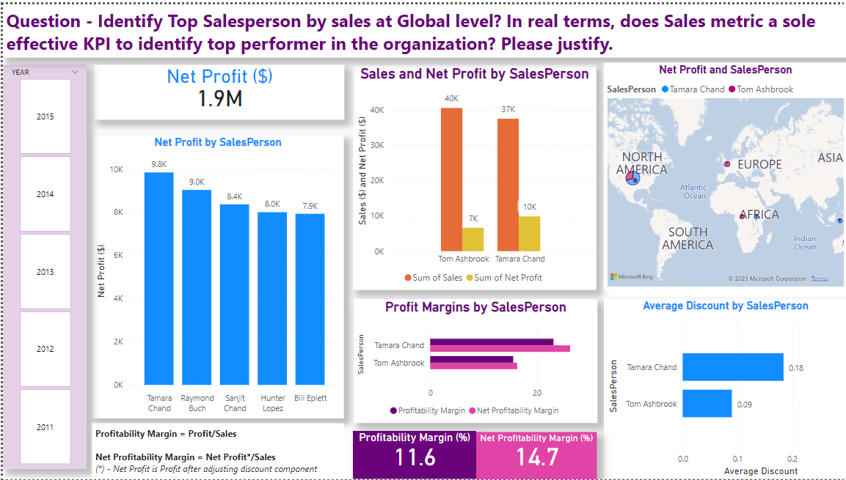

Slide 38
5 – Evaluation

Slide 39
Conclusion – Answer to Question
Question - At an estimated CAGR of 10%, what is expected 2020 sales for the country with highest sales in 2014? Considering top 10 countries by sales, does this country remain at top in terms of profitability margin as well?
Answer – Profitability margin is a class of financial metrics used to assess business’s ability to generate earnings from its revenue. Though, US remains at top in terms of sales, but it is unable to produce enough earnings. For this aspect, South Africa fairs better than US despite of comparatively low sales share than US
Question - Identify Top Salesperson by sales at Global level? In real terms, does Sales metric a sole effective KPI to identify top performer in the organization? Please justify.
Answer – Top Salesperson (Tom Ashbrook) does not seem to be top cash generator for the company. Net profit is better defined term to pick the real performer w.r.t company’s growth. Based on our analysis, Tamara Chand is able to yield more profit than Tom Ashbrook (Tamara Chand is able to bring more money to company than Tom Ashbrook) despite of even giving more discount. Hence, he seems to be better and effective performer in real sense

